Slide 1
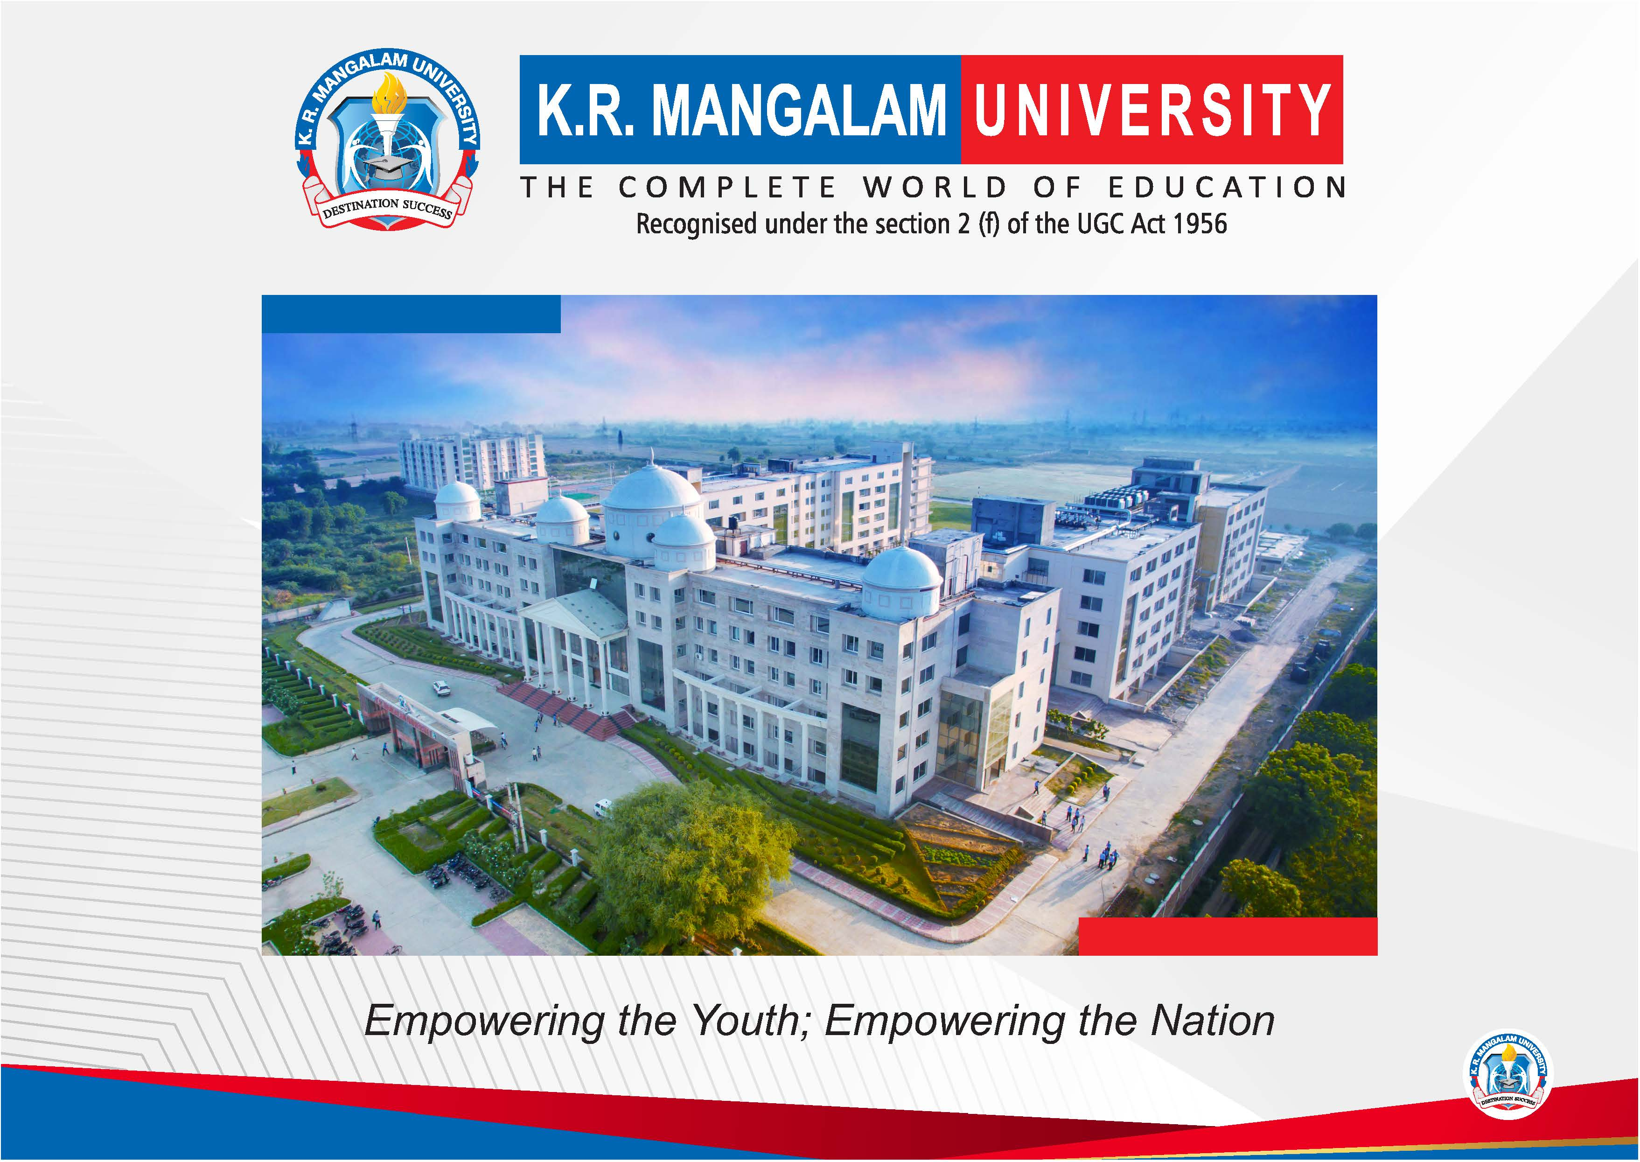

Slide 2


Project Title
Pre-Final Year Project Synopsis
Submitted by
ROLL | NAME
2501350037 | shashwat
 | Naveen anand
 | bharat
Faculty Mentor:
Notes:
New Courses replaced with New Programmes

Slide 3

Project Overview
This project focuses on developing an AI-powered conversational chatbot that interacts with users in a target language (e.g., Spanish) and corrects their grammar mistakes in real time. The bot will help learners improve language skills through interactive conversation, instant feedback, and grammar explanations.
The system uses Natural Language Processing (NLP), Machine Translation, and Grammar Checking techniques to analyze user input, detect errors, and provide corrected responses.
This project is useful in EdTech platforms, language learning apps, and educational institutions.
Notes:
New Courses replaced with New Programmes

Slide 4
Specific Objectives
To build a chatbot that communicates in a target language (Spanish or others).
To detect grammar mistakes in user input.
To provide real-time corrections and explanations.
To improve language learning through conversational practice.
To support multilingual language learning environments.
Notes:
New Courses replaced with New Programmes

Slide 5
Key Features
Conversational AI for real-time chatting
✍ Grammar mistake detection and correction
🌍 Support for multiple languages
📚 Explanation of grammar rules
📈 Learning progress tracking (optional)
🔄 Machine translation for understanding user input
🎓 Educational interface for students
Notes:
New Courses replaced with New Programmes

Slide 6
Project Usecases & Scope
Use Case
Students learning foreign languages
Teachers using AI tools for grammar correction
Online language learning platforms (like Duolingo, Babbel)
Self-learning users practicing conversation
Scope
Real-time text-based conversation
Grammar correction and suggestions
Language translation support
Can be extended to voice input/output in future
Integration with mobile or web applications
Notes:
New Courses replaced with New Programmes

Slide 7
Prototype/Project Flow diagram/Architecture
Start
↓
User Input (Text)
↓
Language Detection Module
↓
Grammar Checking Engine
↓
Machine Translation (If Required)
↓
NLP Processing & Error Analysis
↓
Generate Corrected Sentence
↓
Explain Grammar Rule
↓
Chatbot Response to User
↓
End
Notes:
New Courses replaced with New Programmes

Slide 8
Data & Resources
Data Required
Language datasets (Spanish, English, etc.)
Grammar rules and corpora
Conversational datasets for chatbot training
Resources
Python Programming
NLP Libraries (NLTK, SpaCy, Transformers)
Machine Translation APIs (Google Translate API, MarianMT)
Grammar checking tools (LanguageTool)
Chatbot frameworks (Rasa, Dialogflow, Flask)
Hardware: PC or cloud server
Notes:
New Courses replaced with New Programmes

Slide 9
Methodology
Step 1: Requirement Analysis
Identify target language and user requirements.
Step 2: System Design
Design chatbot architecture and grammar correction modules.
Step 3: Data Collection
Collect language datasets and grammar corpora.
Step 4: Model Development
Implement NLP processing
Integrate grammar checking models
Add translation module
Step 5: Testing
Test with real user inputs
Check accuracy of grammar corrections
Step 6: Deployment
Deploy as a web or mobile chatbot application
Notes:
New Courses replaced with New Programmes

Slide 10
Expected Results & Impact
Expected Results
Users receive corrected sentences instantly
Improved grammar accuracy in language learners
Interactive learning environment
Multilingual communication support
Impact
Enhances language education
Reduces dependency on teachers for basic corrections
Supports self-learning and personalized education
Useful for EdTech companies and educational institutions
Notes:
New Courses replaced with New Programmes

Slide 11
Project Timeline
The project is planned to be completed in several phases.
First, the requirements and objectives of the chatbot system are analyzed and the target language and tools are selected. Next, the system architecture and flow design are prepared. After that, language datasets and grammar resources are collected and processed. Then, different modules such as language detection, grammar checking, translation, and NLP processing are developed and integrated into the chatbot. The system is tested with various inputs to check accuracy and performance. Finally, the chatbot is deployed and the project report and documentation are prepared for submission.
The total project duration is estimated to be around 8–10 weeks.
Notes:
New Courses replaced with New Programmes

Slide 12
THANK YOU

